Slide 1
Development and Applications of
DICE(Dynamic Integrated Consequence Evaluation)
2021 Korean Institute of Hazardous Materials
2021.09.16
Speaker: Dohun Kwon
Kyung Hee University
Department of Nuclear Engineering
Contact: skdmlclsrn11@gmail.com

Slide 2
Table
Background
Method of Development
Mode
Summary
Application

Slide 3
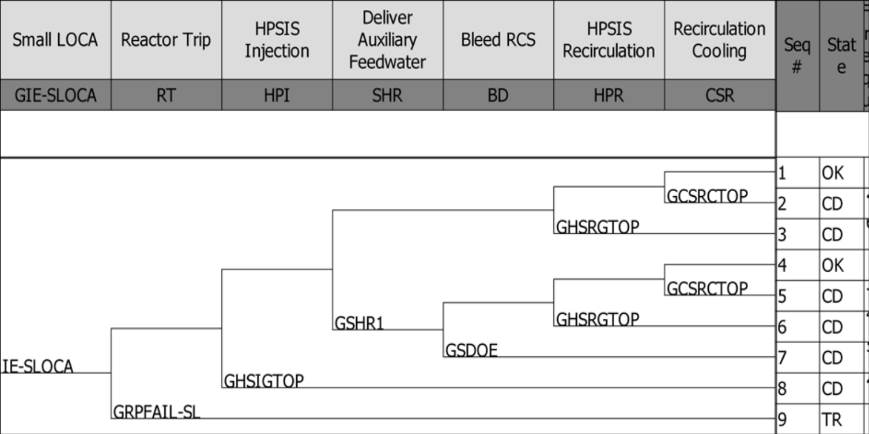
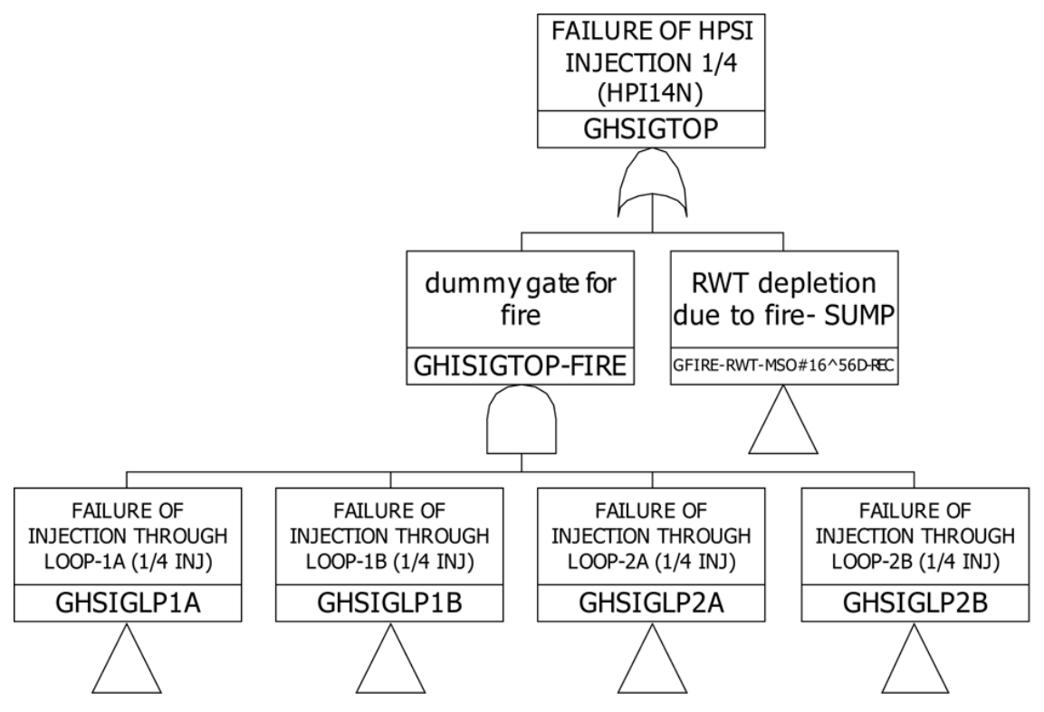
Background
PSA(Probabilistic Safety Assessment)
Methodology for using complex engineering system (ex. Nuclear power plant, Aerospace, etc.)
PSA = Fault Tree + Event Tree
Fault Tree(FT): Analysis method for a state in which the system cannot perform the necessary functions
Event Tree(ET): Analysis method for important event sequence about the selected initiating event
Success
Fail
Event Tree
Falut Tree

Slide 4
Background
Limitation for conventional PSA
Difficulty for consider dynamically nonlinear processes
Temporal dependency
Human error such as Errors of Omission(EOO), Errors of Commissions (EOC)
OVERCOME
IDPSA(Integrated Deterministic-Probabilistic Safety Assessment)
… is a methodology that analyzes the metric related to the safety of the system by reflecting probabilistic (or stochastic) situational changes in the deterministic simulation process of a physical model.

Slide 5

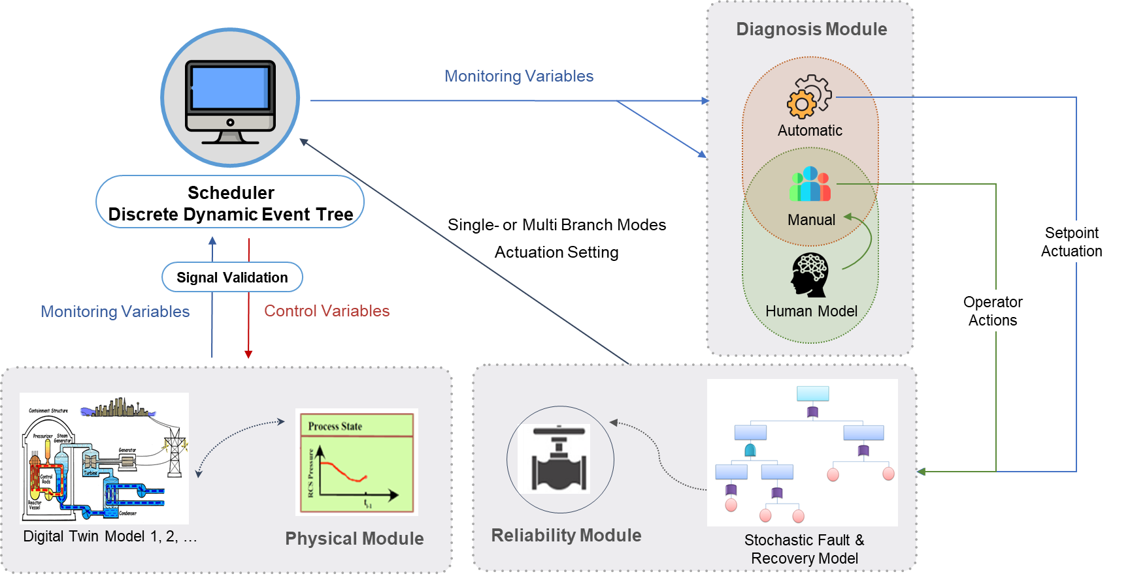
Method of Development
Figure. Architecture and Applications of DICE
Procedure’s coverage
Microscopic analysis of a specific sequence:
Signal Malfunctions
Cyber attacks
Error of commission
Malicious threats
Design basis / Severe accidents
Interconnected systems’ behavior
Super-fast event predictor
Stochastic recovery tasks:
Dynamic analysis of external events

Slide 6

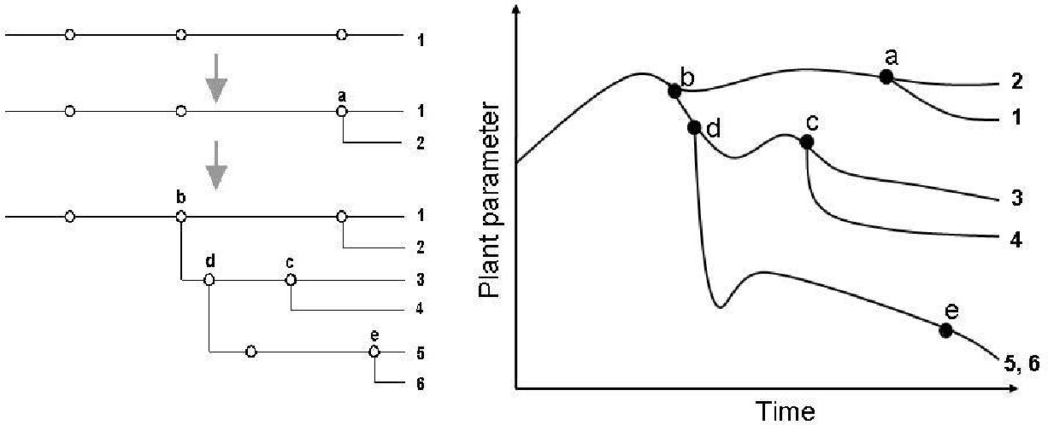
Method of Development (1/4)
Structure
DDET (Discrete Dynamic Event Tree) scheduler in multi-machine/multi-core running environment
Schematic diagram of DICE for Level 1 and Level 2
Example of DDET mechanism

Slide 7
Method of Development (2/4)
Structure
Physical module
Connected with a simulation code or a digital twin model
MARS-KS (Korean regulatory safety analysis code)
Receives monitoring variables from a simulation
Supplies control variables to a simulation
Schematic diagram of DICE for Level 1 and Level 2

Slide 8
Method of Development (3/4)
Structure
Diagnosis module
Auto sub-module
Logical statements for systems’ variables
Ex) Actuation of RPS(Reactor Protection System) or ESFAS(Engineered Safety Feature Actuation System)
Manual sub-module
Human model
Receives monitoring variables
Decides & Supplies branching points
Schematic diagram of DICE for Level 1 and Level 2

Slide 9
Method of Development (4/4)
Structure
Reliability module
Stochastic fault & recovery model
Receives branching decisions
Supplies branching probabilities / control variables
Schematic diagram of DICE for Level 1 and Level 2

Slide 10
Mode(1/2, Mode 1: Multi-branch)
Minimum number of simulations for MECE Spectrum
(Equipment failure check at only a branching point)
Easy tree-structured visualization
Cutset creation and quantification process required
Still deterministic
Capture for Interpolating censored risk
Reliability Module
Diagnosis Module
(Auto Action)
Physical Module
Reliability Module
Simulation
Starts
Diagnosis Module
(Manual Action)
Auto Task
Module ?
dt
dt
dt
dt
Damage!
Single Fail?
Damage!
Scheduler
Manual Task
Module ?
Double Fail?
dt
dt
dt
OK?
All Fail?
In an hour?
In two hour?
OK!
dt
dt
dt
In a day?
Damage?
OK!

Slide 11

Mode(2/2, Mode 2: Single-branch)
Vast amount of simulations for unknown scenarios
(Equipment failure check at everytime)
Difficulty in visualization
Simple quantification
Full stochastic
Capture for extrapolating censored risk
Reliability Module
Diagnosis Module
(Auto Action)
Reliability Module
Physical Module
Diagnosis Module
(Manual Action)
Simulation
Starts
Auto Task
Module ?
dt
dt
dt
dt
Manual Task
Module ?
Scheduler
Single Fail?
dt
dt
dt
Double Fail!
Reliability Module
All Fail?
In an hour?
In two hour?
dt
dt
dt
at 1:00!
OK? or Damage?
Reliability Module

Slide 12
Future research
Mode 1 Applications
Evaluation of the coverage of operating procedures
Detailed analysis of specific sequence
Analysis of maintenance or recovery
Mode 2 Applications
Analysis of unexpected tasks
Analysis of interconnected multiple facilities
Analysis of dependency between human error and time temporal

Slide 13
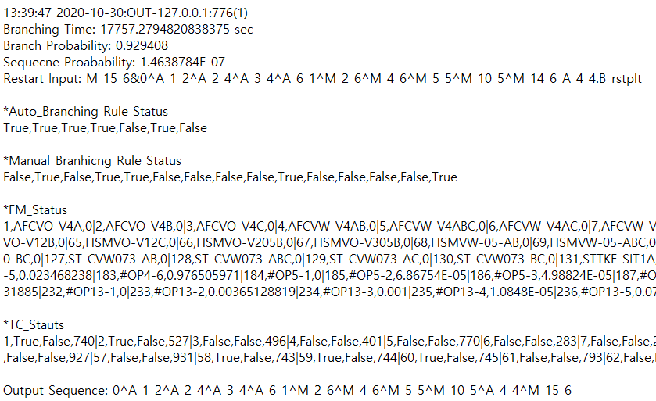
Application
SBLOCA for Reference Model
A: Auto sub-module
M: Manual sub-module
A_1_2: RPS Success
A_2_4: Three HPSI Success
A_3_2: Three LPSI Success A_4_4: Three HPRC Success A_6_2: AFW Failed
M_2_6: RCP Trip
M_4_6: CSP Trip
M_5_5: RHRP Trip
M_10_5: F&B Success
M_15_6: RHRP Operation

Slide 14
Thank you for attention
Email: skdmlclsrn11@gmail.com

